Slide 1
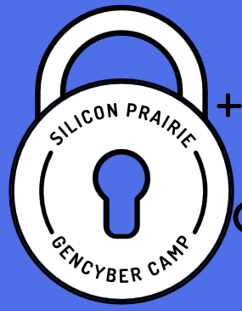



Computer Operating Systems

Slide 2
Cybersecurity First Principles
Domain Separation
Process Isolation
Resource Encapsulation
Least Privilege
Layering
Abstraction
Information Hiding
Modularity
Simplicity of Design
Minimization

Slide 3
Goals of Cybersecurity
Confidentiality
Only approved users/applications/systems can view data/information/systems.
Integrity
Only approved users/applications/systems can change data/information/systems
Availability
Assets are accessible by approved users/applications/systems when needed.

Slide 4
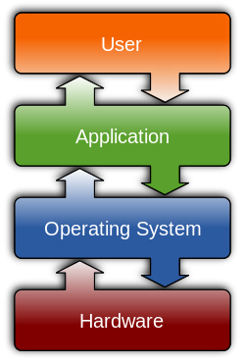
What is an Operating System?
An operating system (OS) is system software that manages computer hardware and software resources (memory, IO, network) and provides common services for computer programs.
Acts as an intermediary between programs and the computer hardware.
Examples?
Notes:
See video at https://youtu.be/pTdSs8kQqSA.

Slide 5

Computer Basics: Understanding Operating Systems https://www.youtube.com/watch?v=pTdSs8kQqSA
Notes:
https://www.youtube.com/watch?v=pTdSs8kQqSA

Slide 6

Clients vs. Servers
A computer network diagram of clients communicating with a server via the Internet. The client–server model is a distributed application structure that partitions tasks or workloads between the providers of a resource or service, called servers, and service requesters, called clients.

Slide 7
Microsoft Operating Systems
Clients
Windows 10, 8, 7
Servers
Windows Server 2016, 2012

Slide 8
Microsoft Operating Systems
Introduction
Shortcuts
https://www.shortcutworld.com/en/win/Windows-Run-Commands.html
See PDF on toolkit drive

Slide 9
Microsoft Operating Systems
Tools
GodMode
SysInternals Suite
MBSA
Malicious software removal tool
Powershell / Command line
Notes:
To be covered on Tuesday

Slide 10
Windows Security Policies
Local Security Policy
Notes:
To be covered on Tuesday with system hardening

Slide 11
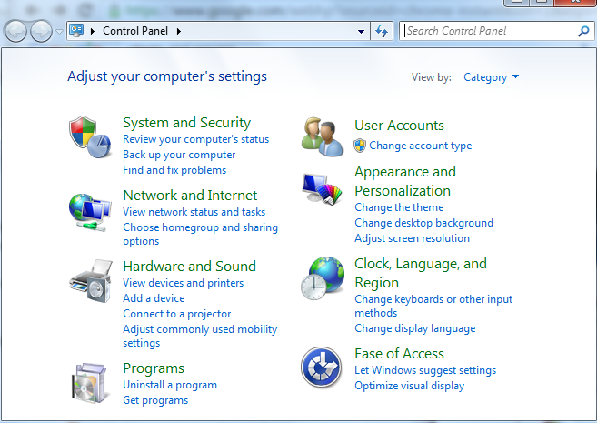
Windows Control Panel
Where many of the basic system changes and configurations can be made
Click Start > Control Panel

Slide 12
Microsoft Operating Systems
Triage
Log into the virtual PC
Work as a team to fill in the worksheet about the computer
Notes:
See worksheet. Should take 10 min.
Have Ss go to Start > Computer (right click) > Properties
Network will be covered in networking section

Slide 13
Windows Server
Used to serve applications
Internet Information Service (IIS)
Sharepoint
SQL Server (database)
Security Configuration Wizard

Slide 14
Linux Operating Systems
Overview / History
Common Terms / definitions
Linux system architecture
Differences and similarities with Windows
Linux command line environment

Slide 15
Linux Operating Systems
Overview / History
Common Terms / definitions
Linux system architecture
Differences and similarities with Windows
Linux command line environment

Slide 16
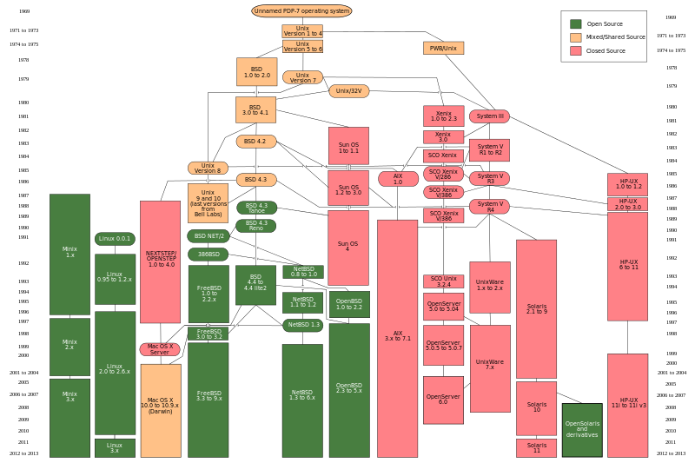
Linux / Unix History

Slide 17

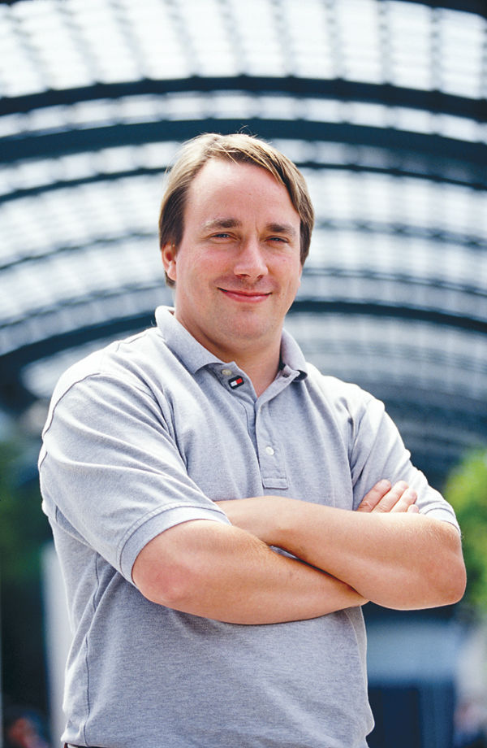
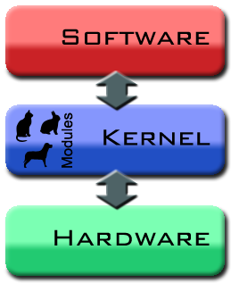
Linux
Founded by Linus Torvalds
Linux kernel

Slide 18
Why Linux?
Many downloadable packages which are free of charge.
Much better computation performance.
Less system restriction on resources.
Kernel is open-sourced and fully customizable.

Slide 19
Disadvantages of Linux
Progress on device driver update ➔ New hardware may not be operational when older Linux is in use.
Something not expected may happen.
Sometimes, you should work in terminal (command lines).
You should “Google” to solve your problem.

Slide 20





Linux Distributions
Raspbian
Ubuntu
Debian
Red Hat (Fedora)
SUSE
CentOS
Websites:
https://distrowatch.com/
http://livecdlist.com/

Slide 21
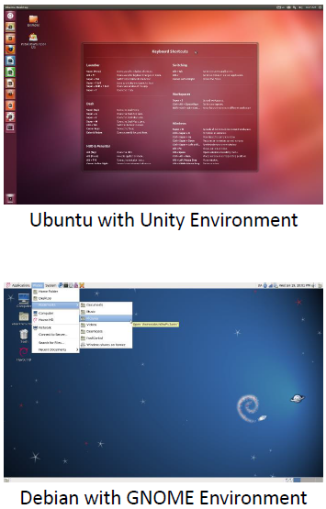
Differences between Linux Flavors
Default desktop GUI environments
Ubuntu – Unity
Debian – Gnome
Different purposes / audiences
Ubuntu / Debian – general
Kali – Security
Different package management and installation
Ubuntu / Debian use APT
Fedora / Red Hat use yum

Slide 22
Differences with Windows
Less expensive
Graphical User Interface (GUI) can be changed
Running tasks from a command line
Less malware on Linux
Smaller hardware requirements

Slide 23
X Window System (X)
It is not required if you run Linux in command-line mode. To use GUI, however, X is definitely necessary.
If hardware acceleration of graphics is needed, you need to further configure X.

Slide 24
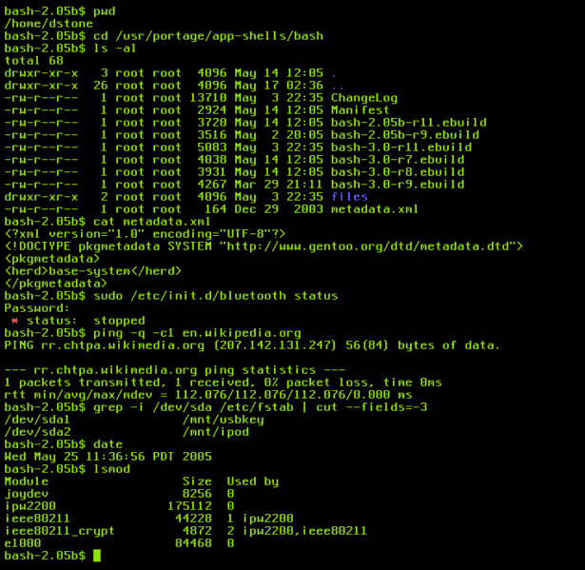
Shell
A user interface using command lines
bash, csh, ksh, …
Notes:
Command line / GUI comparison: http://www.computerhope.com/issues/ch000619.htm

Slide 25
Linux OS – Root Account
Command reference
See PDFs on toolkit drive

Slide 26
Linux Operating Systems
Account types: User and Root
Root – Linux Administrator account
UID: 0
System can have multiple root accounts
Superuser – can do anything on a system
Users can switch to root as needed
Root actions require a password
Authentication vs. Authorization
Root users are authorized to do many different tasks, but they must first authenticate their identity by entering a password.

Slide 27
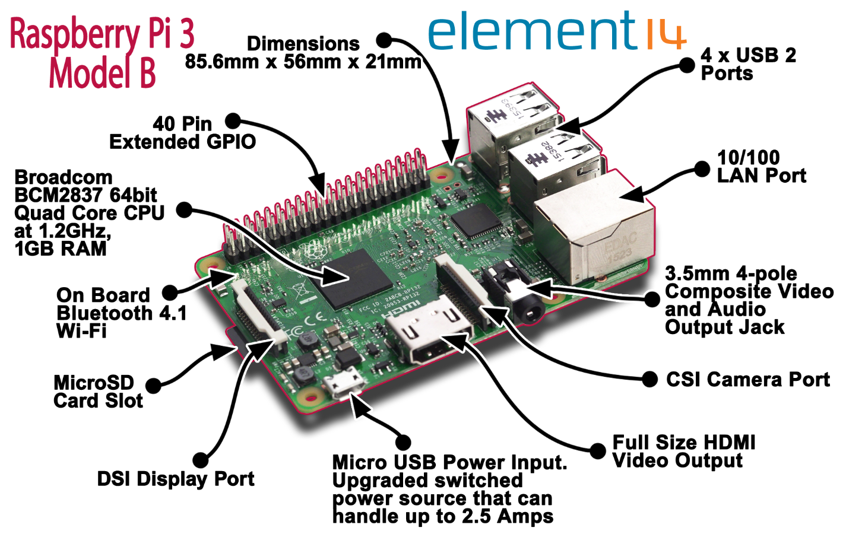
Booting your Raspberry Pi

Slide 28
Using Linux Terminal
Accessing the terminal
When typing commands in Terminal, it is very important to pay attention to capitalization and spaces
Hitting Enter will execute your command and hitting Ctrl+D will close any commands you have running or exit the Terminal
There are numerous Ubuntu command databases and command line tutorials online. Here are a few sites:
https://help.ubuntu.com/community/UsingTheTerminal
http://ryanstutorials.net/linuxtutorial/
http://manpages.ubuntu.com/
http://ubuntu-manual.org/
Notes:
https://www.raspbian.org/

Slide 29
Linux commands
Terminal
man <command> ← the linux manual (help files)
ls ← Lists files & folders in directory (like dir)
ls –l for a long list; ls -la to list all
pwd ← print working directory
cd ← change directory
Notes:
http://www.thegeekstuff.com/2010/11/50-linux-commands/

Slide 30
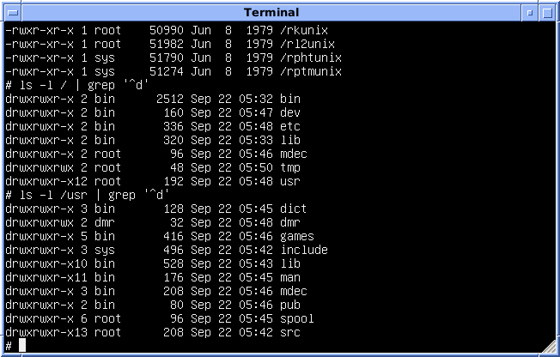
Common directories (aka file systems)
/.
/..
/bin
/usr
/home
/etc
/opt
Notes:
https://www.raspbian.org/

Slide 31
Linux commands
Terminal
cat <filename> ← list file contents
cp / mv / rm <filename> ← copy, move, remove files
mkdir / rmdir <directory> ← make /remove directories
Notes:
http://www.thegeekstuff.com/2010/11/50-linux-commands/

Slide 32
Linux sudo command
Super user / admin access
Allows an authorized user (one with root permissions) to temporarily elevate their privileges using their own password instead of having to know the password belonging to the built-in root account
This command must be used to perform administrative tasks (e.g. adding a user account)
Sudo <command> ← runs command as root
First authenticate with your user password

Slide 33
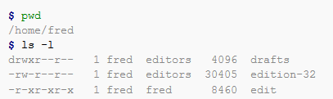
Linux commands
ls ← Lists files & folders in directory (like dir)
ls –l for a long list
ls -la to list all ← shows “hidden” files/folders

Slide 34

Linux Text Editors
Editing plaintext files.
Used for scripting.
Vim / VI
gEdit
Nano
Emacs
leafpad
Notes:
http://www.thegeekstuff.com/2009/07/top-5-best-linux-text-editors/

Slide 35
Linux Shell Scripting
Anything you put on a command line can go in a script.
Text file that begins with #!/bin/bash
Usually have .sh file extension (but doesn’t need it)
Must be set to executable
Use the chmod command
chmod 755 <filename>
Notes:
http://linuxcommand.org/writing_shell_scripts.php
http://www.howtogeek.com/67469/the-beginners-guide-to-shell-scripting-the-basics/

Slide 36
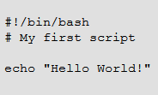
Linux Shell Scripting
Test it
vim test.sh
#!/bin/bash
# Hashtag / Pound used for comments / ignored
Echo “Hello World!”
pwd
ls
Run it
chmod 755 test.sh
./test.sh
Notes:
http://linuxcommand.org/writing_shell_scripts.php
http://www.howtogeek.com/67469/the-beginners-guide-to-shell-scripting-the-basics/

Slide 37
Bash Exercise
See handout

Slide 38
Operating Systems
Principles:
Least Privilege
Layering
Abstraction
Information Hiding
Modularity
Simplicity of Design

